Slide 1

Database Project
Female Indicator Well-Being (FIWB)
Team members:
Guillaume Capelli & Hilda Monterrubio
October 9th, 2023
G

Slide 2
Agenda
H
Project Description
Technical Challenges
Process
Main results
Closure
1
2
3
4
5

Slide 3
Project Description
G
Planning available here > https://trello.com/b/HKQZIrwm
Data source > World Bank > API connection
Scope > gender > female-related data
Indicators we selected to build our own female well-being indicator:
Educational attainment: Percentage of females who have at least completed lower secondary
Unemployment: Percentage of females with basic education that are unemployed
Equality: Percentage of companies led by female managers.
Equality: Time required to start a business, female
Equality: Time required to start a business, men (for comparison purposes)
1
2
3
4
5

Slide 4
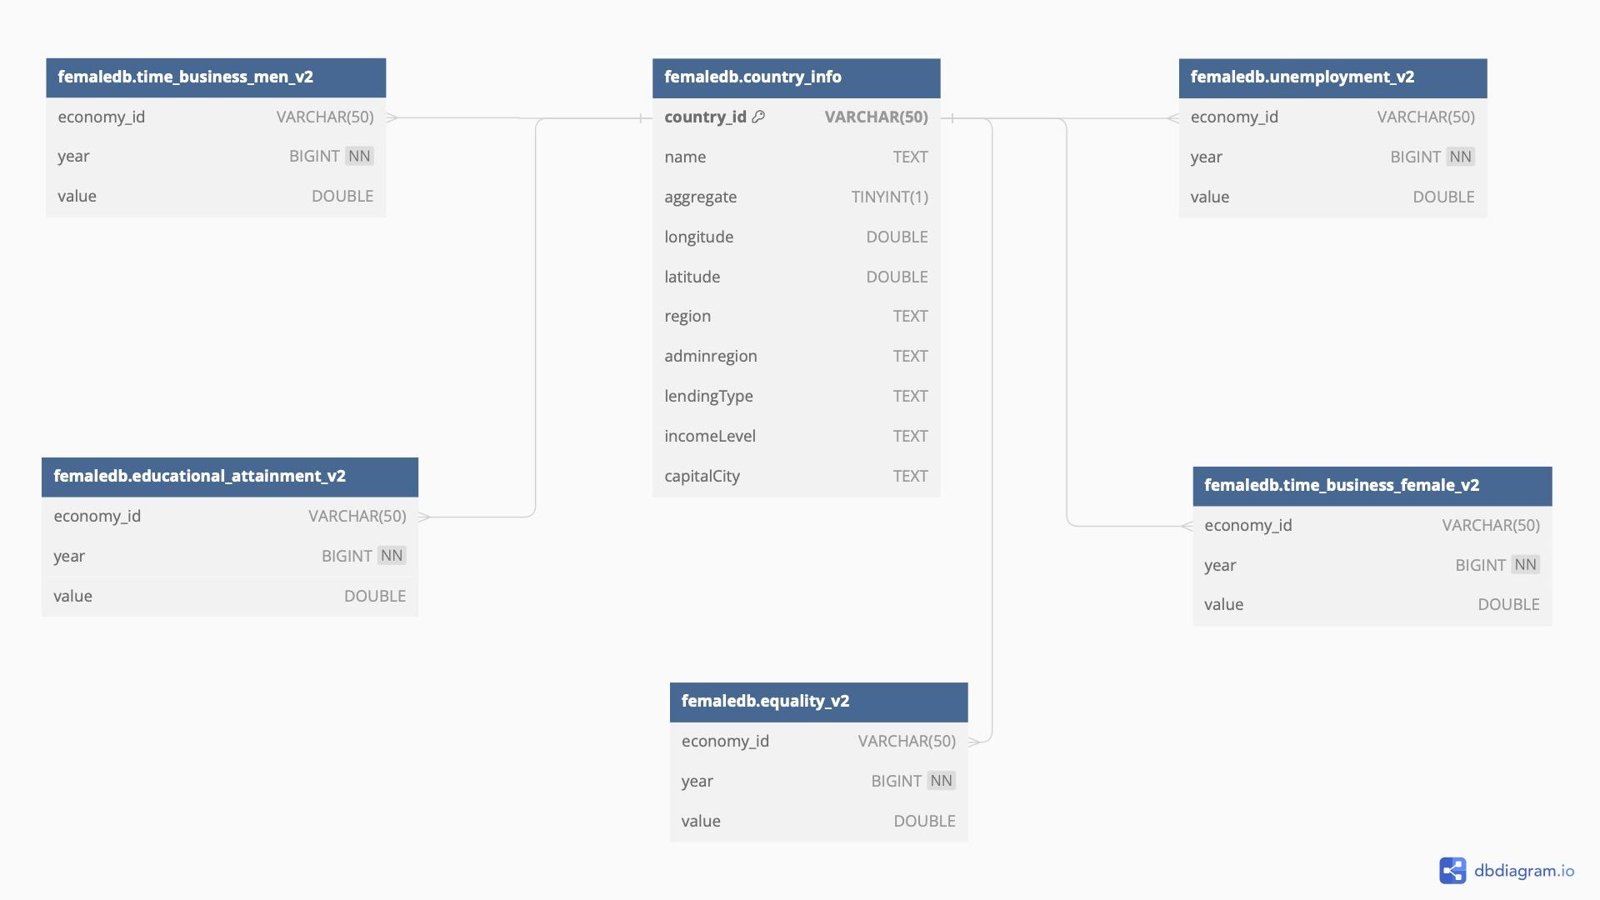
ER model/data schema
Entity relationship model
H

Slide 5
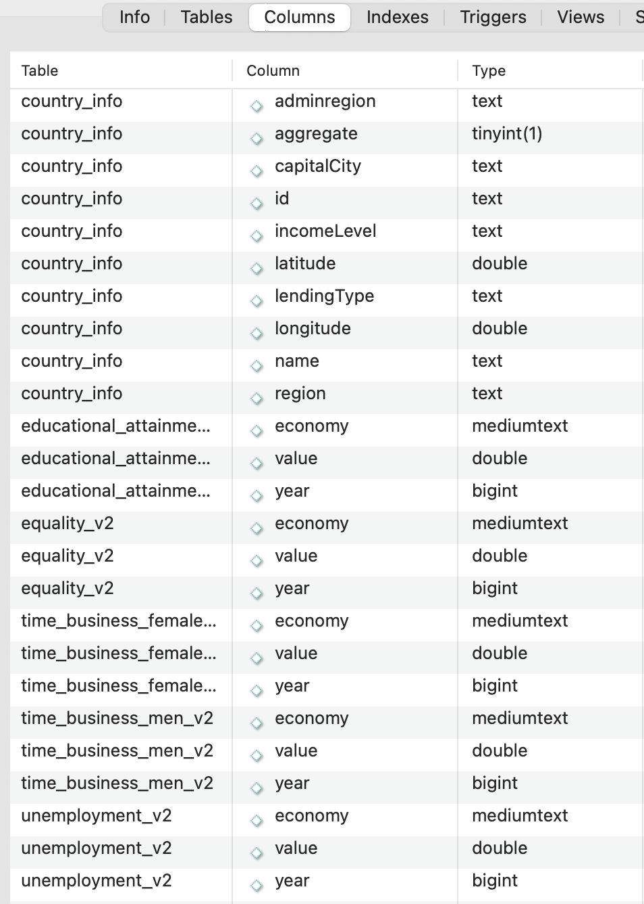
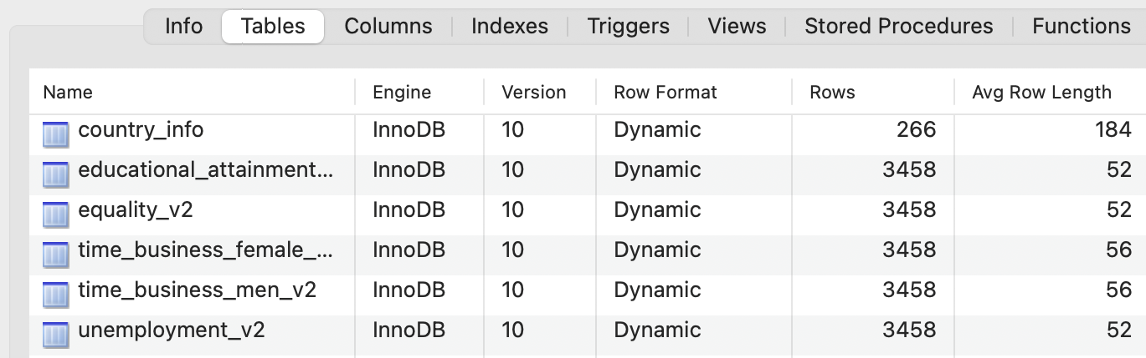
Data schema
G

Slide 6
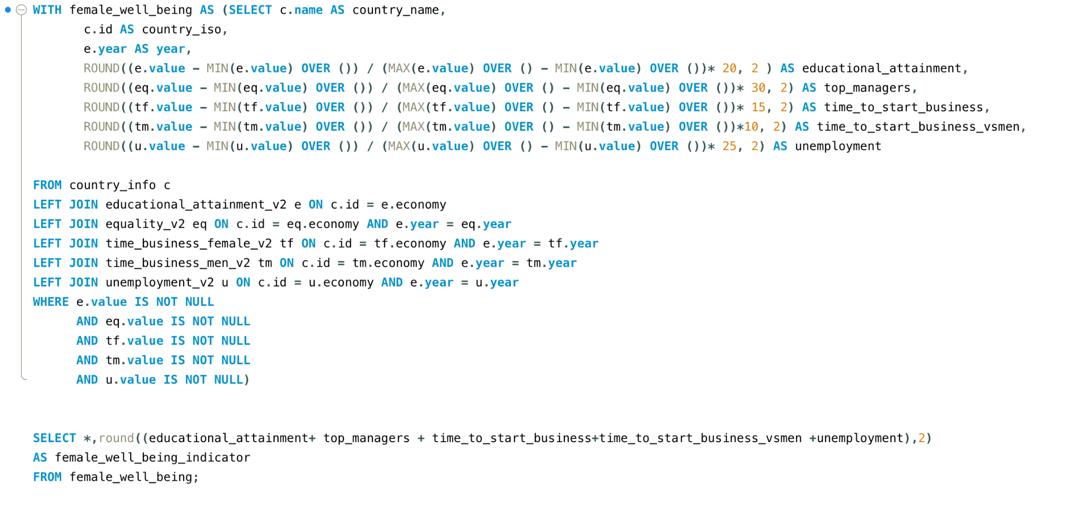
Main Query
H

Slide 7
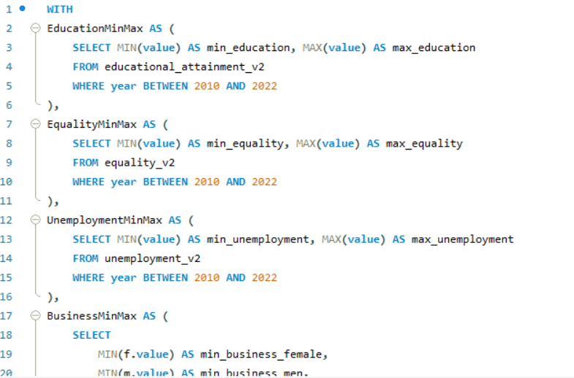
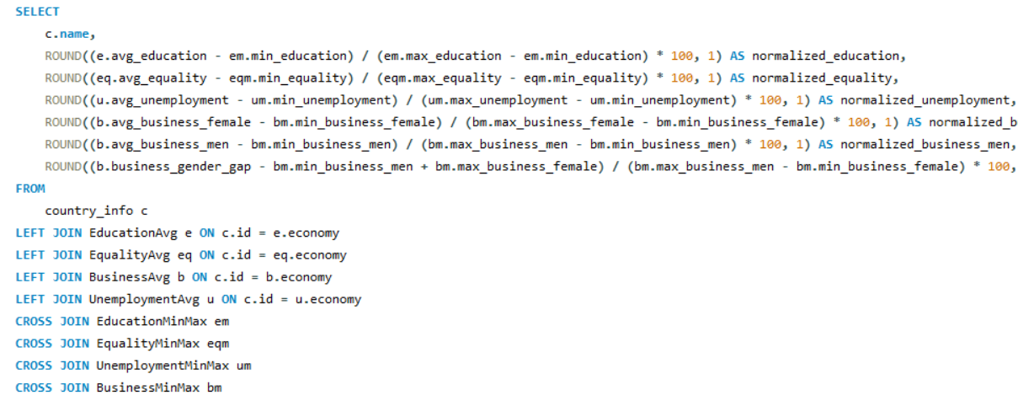
AVG Query
G

Slide 8
Methodology for the composite indicator
H
Normalization: Adjusted metrics to a similar scale.
Weight Assignment: Assigned a weight to each metric based on our perceived importance.
Educational attainment: Percentage of females who have at least completed lower secondary (20%)
Unemployment: Percentage of females with basic education that are unemployed (30%)
Equality: Percentage of companies led by female managers (15%)
Equality: Time required to start a business, female (10%)
Equality: Time required to start a business, men (25%)
Calculation of final indicator = Sum (Metric weight * Normalized metric value)

Slide 9
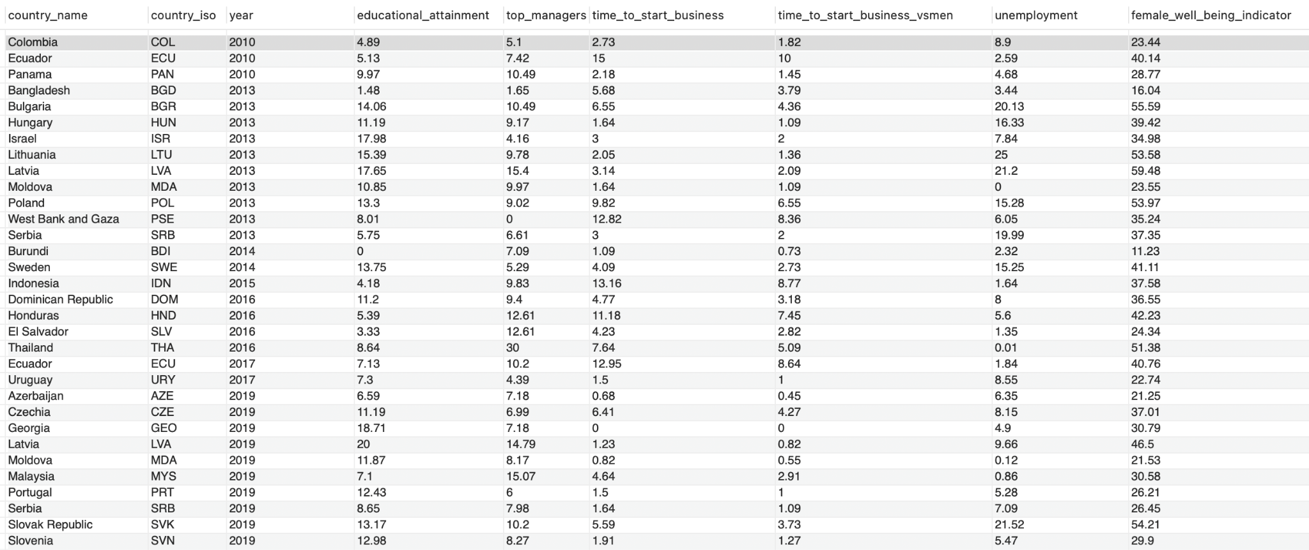
H

Slide 10
2. Technical challenges
G
What was the most important technical challenge you faced?
Ensuring that the selected indicators were providing us with data
Cleaning the data accordingly
Exporting the DataFrames into a SQL database in the required format
How did you overcome those challenges?

Slide 11
3. Process
G
High-level process:
Created a project plan in Trello
Chose a subject and started digging into the available data sources
Tested a couple of indicators as there were many with ‘null’ data
Narrowed down our scope and selected our 5 indicators
Collected the data, created our Dataframes and exported them into our SQL database
Created our ER model
Sorted, cleaned and filtered the data
Implemented the queries
Worked on the methodology of our composite Indicator

Slide 12
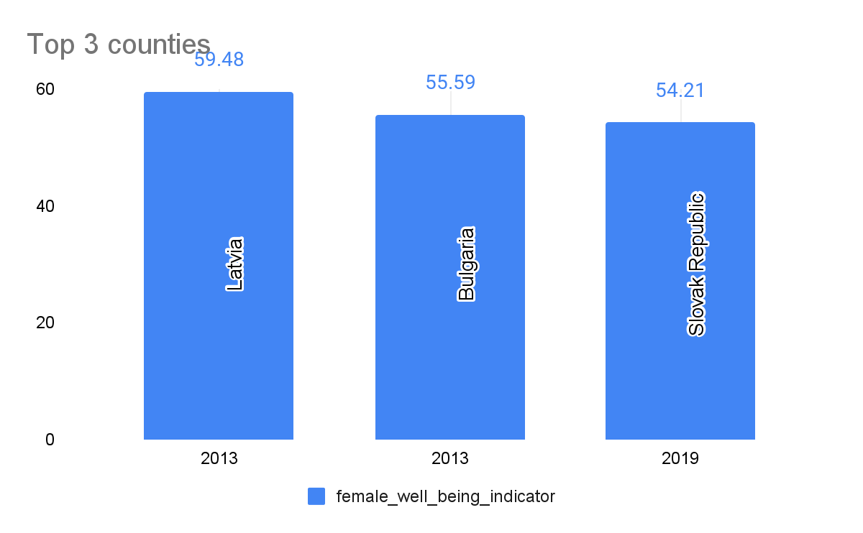
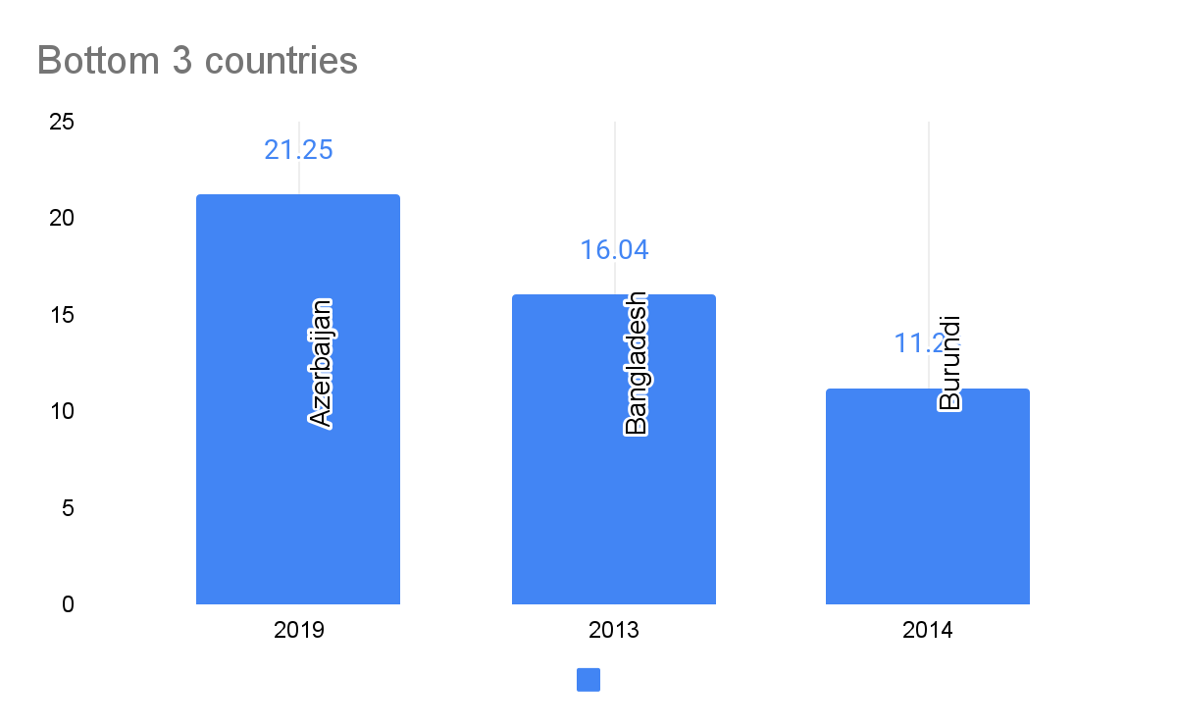

4. Main results
H

Slide 13
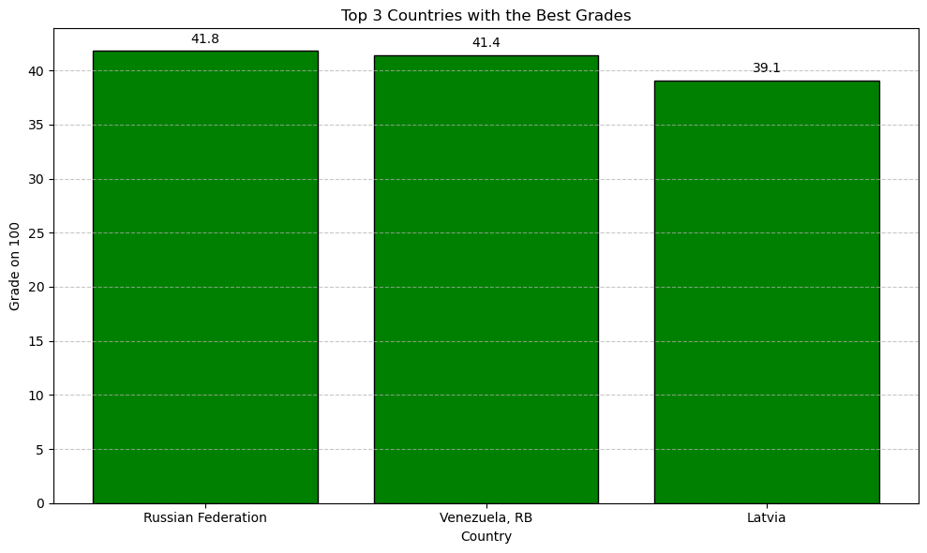
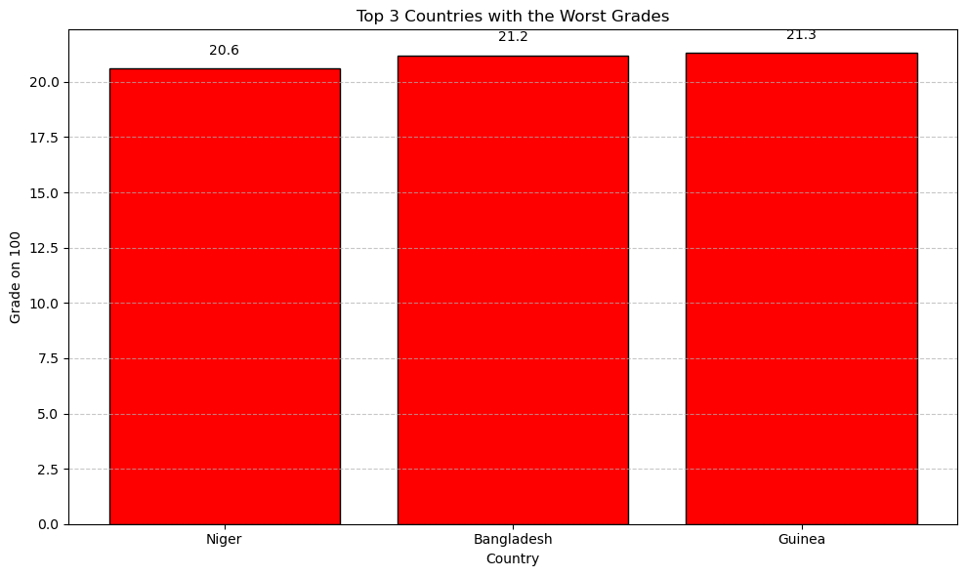
4. Main AVG results
G

Slide 14
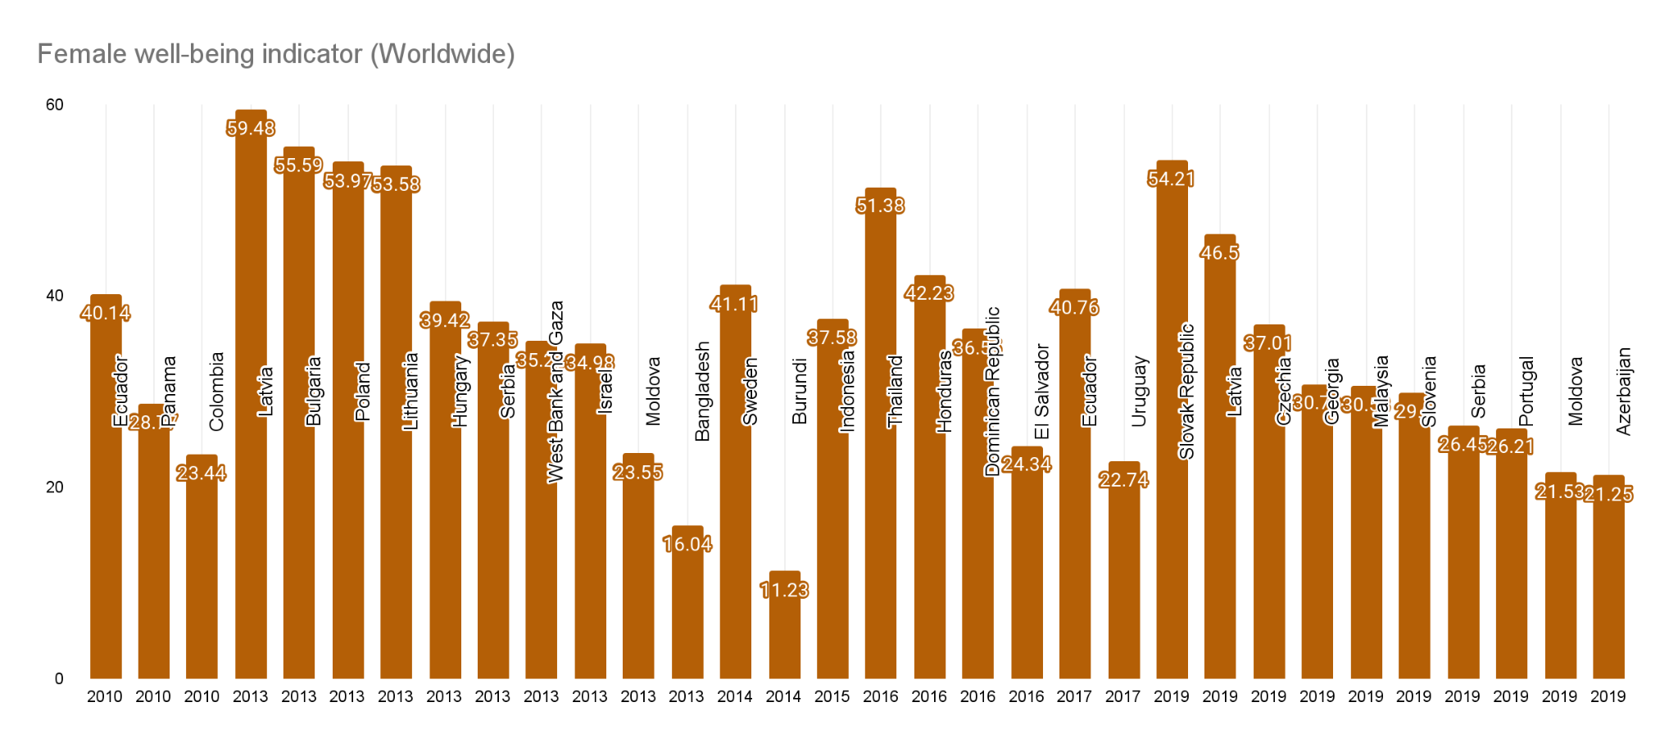
4. Main results
H

Slide 15
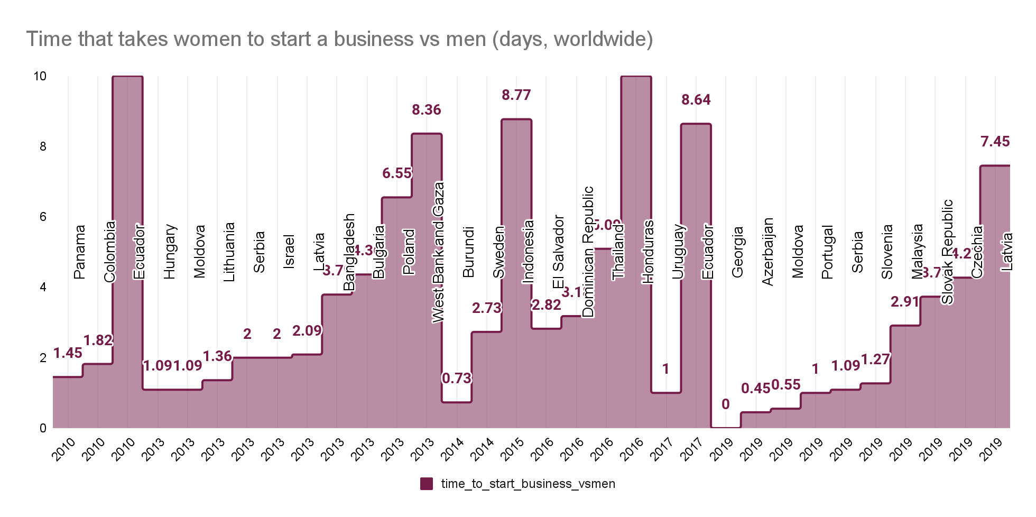
4. Main results
H

Slide 16
THANK YOU!
Questions?

